Slide 1
Automatic electrostatic discharge tester.
Viktor Hugo Hersom From

Slide 2
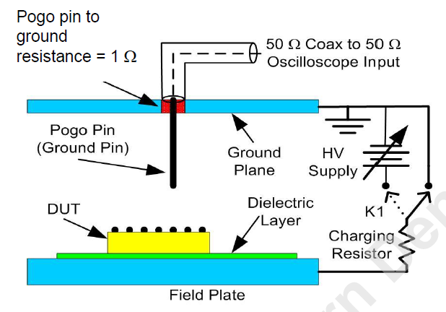
What is the problem?
Electrostatic discharge (ESD) events.
39 – 48% of all product failures in industry related to ESD.
JS-002-2018 test standard.
Used to measure discharge from a device.
Time-consuming to complete.
The most important parts are:
Pogo pin
Ground plane.
Device Under Test (DUT)
Oscilloscope
Notes:
Electrostatic discharge is a phenomenom, where a voltage potential is built up across two or more components that are insulated from each other.
These voltages can be strong enough to cause a breakdown of the material between them, forming a conductive path.
When that happens, the voltages will be discharged. These voltages can be strong enough to damage the components.
Indeed, an estimated 39 – 48% of all product failures in industry are caused by some form of electrostatic discharge.
While the discharges caused by a human worker on a component are well understood and covered by the Human Body Model, the corresponding discharges caused by components discharging on each other are not so well understood.. Ergo, it is necessary to test the component by following a very specific test procedure.
In this test, the component to be tested on is placed on a dieletric layer and charged through a field plate to a specified voltage.
A pogo pin is then connected to a ground plate and brought in contact with all exposed metal parts of the component.
When that happens, a discharge will occur.
This discharge is then measured by an oscilloscope connected to the whole setup and the waveform of the discharge is stored for later analysis.

Slide 3
What is electrostatic discharge?
Triboelectrification.
Electrons are transferred between materials when there is contact.
Charges build up on the two materials.
Electrostatic discharge.
The material between the two charges breaks down.
A conducting path is formed.
Charges move from one component to another.
Notes:
What exactly is electrostatic discharge?
Electrostatic discharge is a phenomenom that happens when two charges, separated by an insulating material, have become strong enough to cause a breakdown of the material between them. This forms a connecting path between the two components, where charge can move along it.
The actual buildup of charge happens due to a process called triboelectrification.
Triboelectrification is when electrons are transferred between two materials, that are in contact with each other.

Slide 4
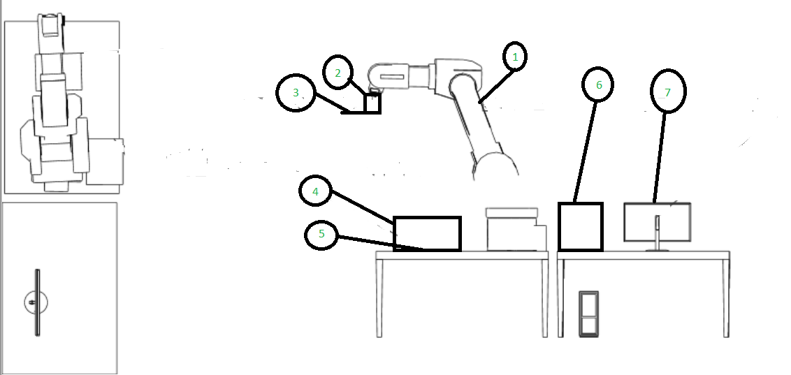
The concept.
A Kawasaki robot arm
A holder consisting of three parts:
Robot tool strut.
Ground plate.
Sensor mount.
A distance sensor and a camera.
A box designed to eliminate shadows.
The Device Under Test (DUT)
An oscilloscope.
A computer used to control everything.
Notes:
For the concept, I am using a Kawasaki robot arm already available for moving the holder.
The holder consists of three parts: a robot tool strut, a ground plate and a sensor mount.
I will also be using a camera and distance sensor.
Obviously, lighting is important, so I’ll also have a box designed to eliminate shadows.
The Device Under Test will be placed inside the box.
There will also be an oscilloscope for measuring the discharge coming from the oscilloscope.
And finally, a computer will be used to control everything.

Slide 5
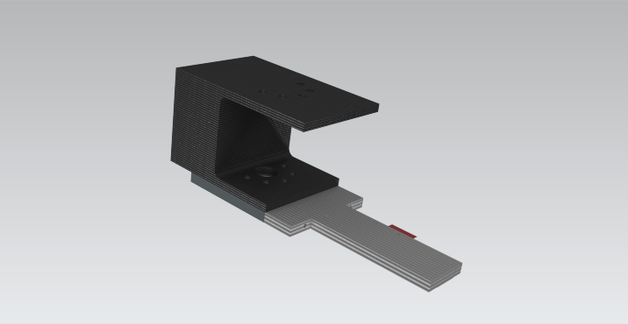
The holder.
The holder is designed to accommodate:
A ground plate.
10 1-ohm resistors.
A pogo pin.
A distance sensor and camera.
The holder consists of three parts:
A robot tool strut.
A ground plate.
A sensor mount.
Notes:
The holder is designed to accommodate:
A ground plate.
10 1-ohm resistors.
A pogo pin.
A distance sensor and camera.

Slide 6
Hardware.
See3 Cam 130.
VL53L4CD distance sensor.
Force-sensitive resistor.
Oscilloscope.
Notes:
For the hardware, I am using four different units:
See3 Cam 130.
VL53L4CD distance sensor.
Force-sensitive resistor.
Oscilloscope.
I am now going to go through some of the theory behind each of the units.

Slide 7
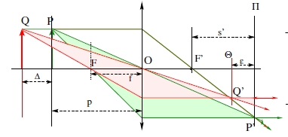
See3 Cam 130
Requirements:
Must be USB – or I^2C – enabled.
Must have a resolution of at least 640x480 pixels.
How does it work?
Image P’ is formed of object P on plane II
CMOS sensor captures the image.
Notes:
The requirements for choosing this particular sensor are:
Must be USB – or I^2C – enabled.
Must have a resolution of at least 640x480 pixels.
How is an image created?
What is shown here is the principles of image formation.
Light coming from an object at a point P passes through a lens centered on a point O and is focused on a point F’, known as the focal point.
As long as the image plane II is behind the focal point, an image P’ is then formed. This image can be captured by the use of either photographic film or an image sensor.
If the object at point P is moved to a new point Q, the corresponding image is now no longer formed on the image plane II, but on a new image plane theta.
This image is captured by the use of a CMOS sensor.
CMOS stands for Complementary Metal-Oxide Semiconductor.
The semiconductor material most used today is silicon.
This is because silicon is a semiconductor and can be used as a diode.
When a photon hits it, the diode will then open, causing a flow of current to occur over the diode.

Slide 8
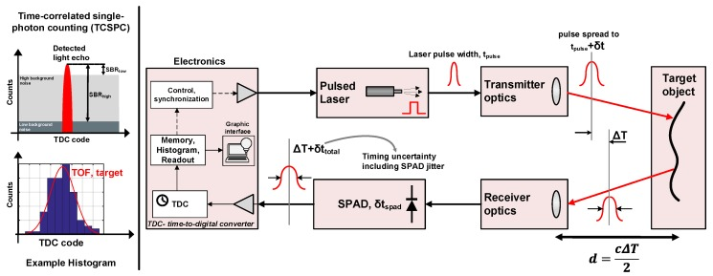
VL53L4CD distance sensor.
Requirements:
Accuracy < 2 mm.
How does it work?
Laser sends out signal.
Signal is encoded.
When signal is sent out, a timer is started
Signal is reflected by target.
Timer is stopped, when signal returns.
L = c/2*T_TOF
Notes:
For the distance sensor, the VL53L4CD distance sensor is chosen, based on the requirement that the accuracy of the measurement should be less than 2 mm.
It works in the following way:
Laser sends out a signal.
This signal is then encoded.
When the signal is sent out, a timer is started.
The signal then is reflected off of a target.
The timer is stopped, when the signal returns.
The distance can then be calculated as L = c/2*T_TOF

Slide 9
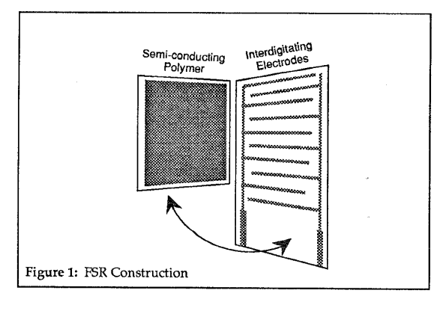
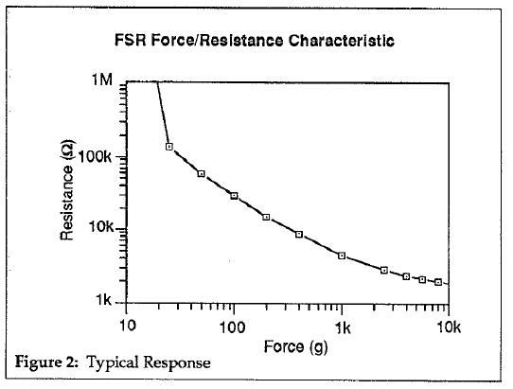
Force-sensitive resistor.
Requirements:
Minimum force measured: 1 N.
Maximum force measured: 70 N.
Not ESD-sensitive.
How does it work?
Two polymer films.
Thin sheet of ”fingers” on the bottom layer.
As ”fingers” are stretched, their resistance decreases.
Notes:
The requirements for choosing this sensor are:
Minimum force measured: 1 N.
Maximum force measured: 70 N.
Not ESD-sensitive.
A force-sensitive resistor consists of a series of metallic ”fingers” deposited on a polymer film.
As force is applied to the ”finegrs”, their resistance decreases.
This drop is an exponential drop and can be measured by using the resistor in a voltage divider.

Slide 10
Software
Five threads:
Video.
Robot control.
Oscilloscope.
Arduino.
Interface.
Notes:
For the software, in order to make it fail-safe, it is split up into five different threads, each with their own unique responsibility:
Video.
Robot control.
Oscilloscope.
Arduino.
Interface.
The most important ones are:
Video.
Robot control.

Slide 11
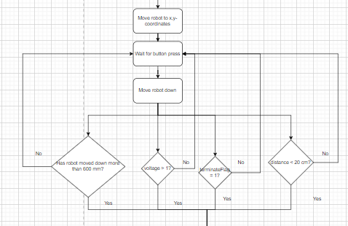
Robot control
Steps:
Move robot to x,y-coordinates.
Wait for button press.
Move robot down.
Stop the robot if:
Robot has moved down more than 600 mm.
The measured voltage is above 1 V.
TerminateFlag is set to 1.
The measured distance is below 20 mm.
Notes:
The robot control thread has to go through several steps:
Move robot to x,y – coordinates. The x,y – coordinates are determined by the Video-thread.
Wait for button press.
Move robot down.
Stop the robot if:
Robot has moved down more than 600 mm.
The measured voltage is above 1 V.

Slide 12
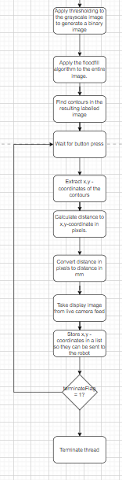
Video thread
Steps:
Generate a binary image.
Apply floodfill.
Find contours in the resulting image.
Wait for button input.
Extract x,y – coordinates.
Calculate distance to coordinates.
Convert distance to mm.
Send distance to robot.
Notes:
The Video thread is responsible for determining the position of a target.
To do this, it is necessary to go through several different steps:
First, the thread has to generate a binary image.
Following this, the floodfill algorithm can be applied to segment the image.
After this, the contours can be found in the resulting image.
Then, the x,y coordinates can be found for the contours and the distance from the center of the image can be found.

Slide 13
Different concepts for the solution.
CamDist
Sphereo
Stereo image method.
Imaging and ranging combined.
Notes:
For the solution, obviously, several different design concepts were considered.
The most important ones I want to mention here are:
CamDist.
Sphereo.
Stereo image method.
Imaging and ranging combined.

Slide 14
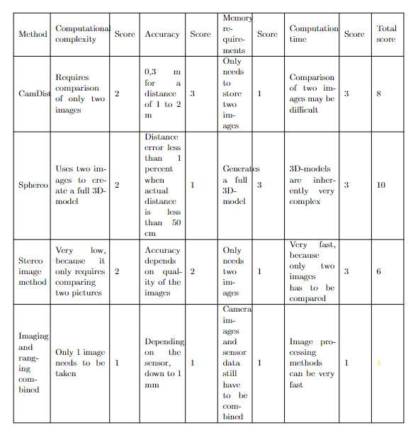
Comparison of the different methods
Criteria:
Computational complexity.
Accuracy.
Memory requirements.
Computation time.
Notes:
In order to choose between the different approaches, I set up a number of criteria for selecting the best approach.
These criteria are:
Computational complexity.
This is based on the knowledge that the more complex the computations are, the more time the computer has to spend on them.
This is given a rating on a scale from 1 – 5, where 1 is the best and 5 is the worst. It is based on the number of pictures needed for each method to work.
picture: 1.
Pictures: 2.
Pictures: 3.
Pictures: 4.
5 pictures or more: 5.
Accuracy. One of the stated requirements for this project is that the measurement of the distance to the object should be less than 2 mm.
Less than 2 mm: 1.
Between 2 and 3 mm: 2.
Between 3 and 4 mm: 3.
Between 4 and 5 mm: 4.
5 mm or above: 5.
Memory requirements: None of the methods considered have a stated minimum memory need. Hence, the assessment of this criteria is more an evaluation than anything else.
Very low: 1.
Low: 2.
Medium: 3.
High: 4.
Very high: 5.
Computation time:
Less than 10 ns: 1.
Less than 100 ns: 2.
Less than 200 ns: 3.
Less than 300 ns: 4.
300 ns or above: 5.
As you can see, because the method Imaging and ranging combined only requires one picture being taken and uses a sensor to measure the distance, it scores the lowest and is therefore the best method. Hence, it is chosen as the method to use.

Slide 15
Imaging and ranging combined
One camera used in combination with a range-finding sensor to determine position and range.
Methods for ranging:
LiDAR.
RADAR.

Slide 16
Image processing
Grayscale.
Thresholding.
Finding contours.
Finding x,y-coordinates.
Notes:
Imaging and ranging combined relies on the use of image processing.
For the image processing, there are several steps that has to be completed before any useful information can be extracted from the image.
This includes converting the image to a grayscale image, applying thresholding, finding contours and finding the x,y-coordinates of the component that is discovered.

Slide 17
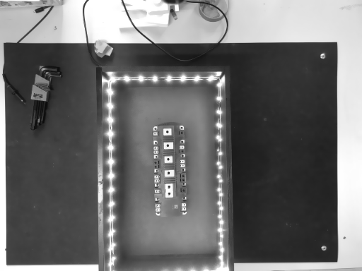
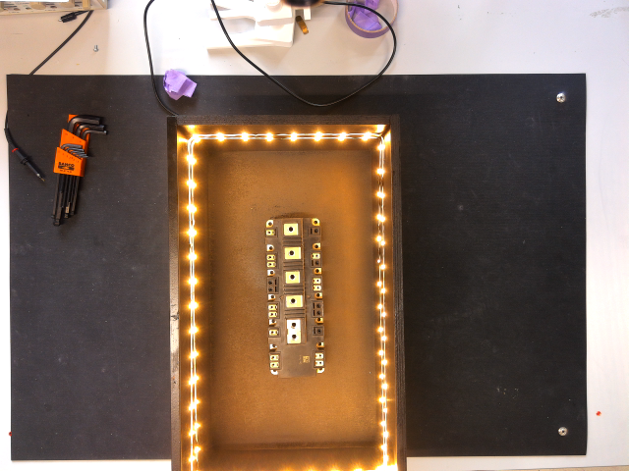
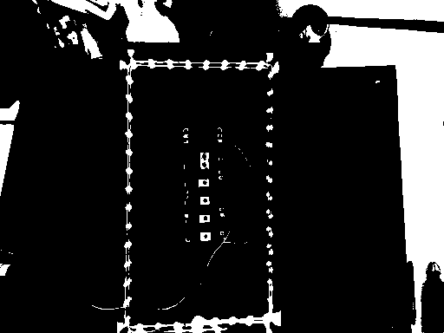

Image processing theory.
Grayscale:
Combine the three color channels into one channel.
Value then represents the intensity of light.
Thresholding:
Convert the grayscale image into a binary image.
If intensity is above a threshold value: 255.
If intensity is below a threshold value: 0.
Finding contours:
findContours()-function from OpenCV.
Extracting x,y-coordinates:
The boxPoints()-function from OpenCV.
Notes:
Converting an image to grayscale means combining the three colour channels of a full-colour image and combining them into one channel.
Each channel is an 8-bit integer and the resulting value will therefore also be an 8-bit integer. This value then represents the intensity of light for that given pixel.
This value can be any whole number in the range 0 – 255.
Thresholding means going through the entire image and setting each pixel above a certain value to 255 and any pixel below it to 0. This generates an image consisting purely of bright and dark spots, also called a binary image.
After this, it is possible to look for connected components through the use of the findContours()-function from OpenCV. It looks for connected components in the entire image.
Having found the list of contours in the image, it is possible to find the corner points of any boxes in the image by using the boxPoints()-function from OpenCV.

Slide 18
Image segmentation
Possible methods:
Watershed.
K-means segmentation.
Color segmentation.
Contour segmentation.
Template matching.
Floodfill.
Notes:
In order to ensure that the detection of the component is good, I also segment the image.
Image segmentation means to split the image into separate regions, that can then be analysed or manipulated according to the needs of the project.
There are several methods available for segmenting an image:
Watershed segmentation.
K – means segmentation.
Color segmentation.
Contour segmentation.
Template matching.
Floodfill.

Slide 19
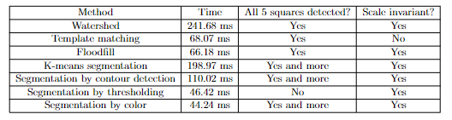
Comparison of the different methods
Notes:
In order to select the best method, I have set up a number of criteria for selection.:
Time. This criterium is based on the requirement that the measurement has to be completed within 1 minute.
All 5 squares detected? This is based on the requirement that the software has to be able to detect the target.
Scale invariance. The software has to be able to work at several different distances. This means that it has to be scale invariant.
Based on this, the floodfill algorithm is chosen as the best method to use.
This is in spite of the fact that segmentation by color is faster than floodfill. However, segmentation by color is susceptible to changes in lighting and therefore, is not useful.

Slide 20

Floodfill.
How does it work?
Finding a seed point.
Visit the neighbouring pixels.
Mark them if they are unmarked.
When two neighbouring regions meet:
Note the conflict.
After the entire picture has been marked, resolve the conflict.
Notes:
The basic assumption for this algorithm is that the image can be split up into background pixels and foreground pixels. This is true for binary images, because in a binary image, any black pixels can be considered as the background and any white pixels can be considered as the foreground.
The method works by first finding any pixels in the foreground that has not been assigned a label yet.
It assigns it a label and then visits its neighbours. These neighbours are found by applying a kernel to the image. This kernel can be either 4 – connected or 8 – connected.
Any unmarked foreground pixels within that kernel are then assigned the same label.
However, if one of them already has a label, then the conflict is stored in a separate list and resolved after the entire image has been labeled.
The way it is resolved is by choosing the lower of the conflicting labels and continuing to do this until all conflicts have been resolved.

Slide 21
Experimental results.
Force-sensitive resistor.
Distance sensor.
Oscilloscope.
Notes:
Now, I am going to go through the experimental results for the:
Force-sensitive resistor.
Distance sensor.
Oscilloscope.

Slide 22
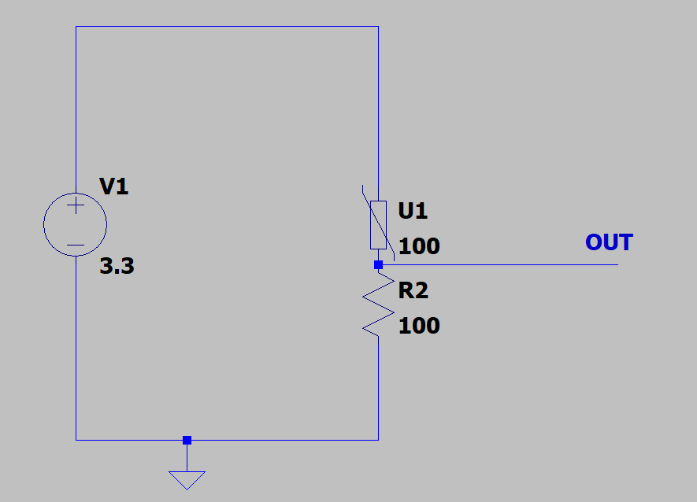
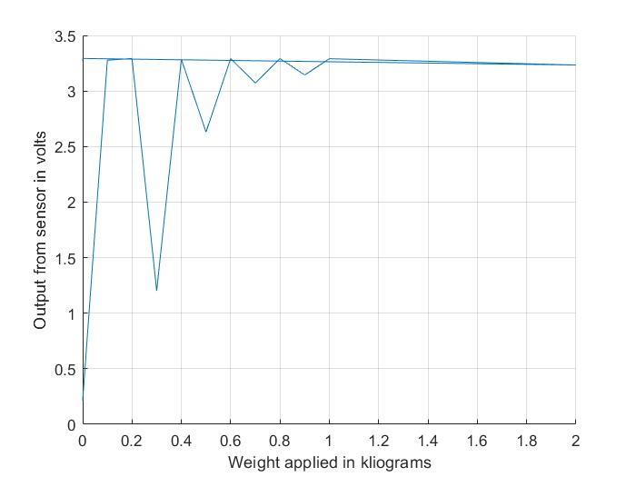
Test of force-sensitive resistor
Notes:
What you see here is the output voltage from the force-sensitive resistor for a weight ranging from 0 kg to 2 kg.
This is equivalent to a force ranging from 0 to 20 N.
The resistor is set up in a voltage divider and is represented here
What is important to note here is that the voltage increases in a manner inversely proportional to the resistance.
This proves that the resistor can be used to sense a force ranging from 0 to 10 N.

Slide 23
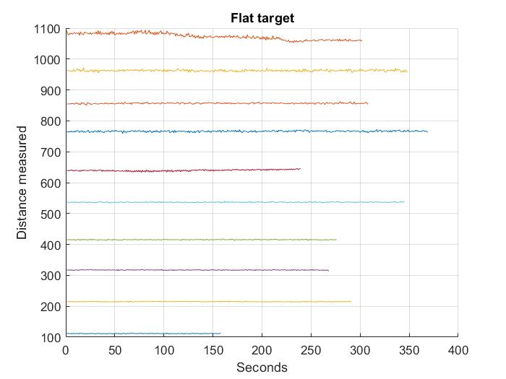
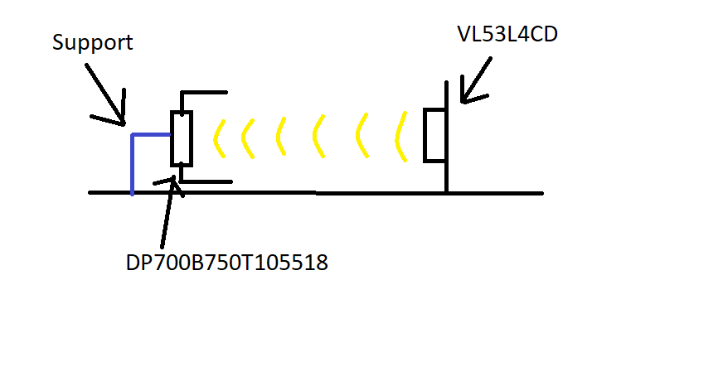
Test of VL53L4CD distance sensor.
Notes:
What you see here are the results for the VL53L4CD distance sensor.
As can be seen in the measurements, the sensor has an accuracy of less than 2 mm.

Slide 24
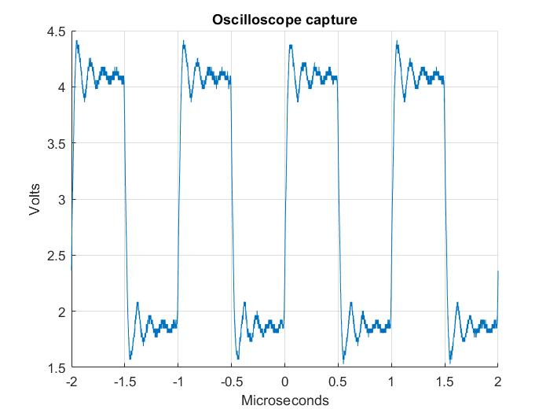
Test of oscilloscope capture.
Notes:
What you see here is the result of the test of the oscilloscope capture.
It’s important to see that the capture goes up to 4 volts

Slide 25
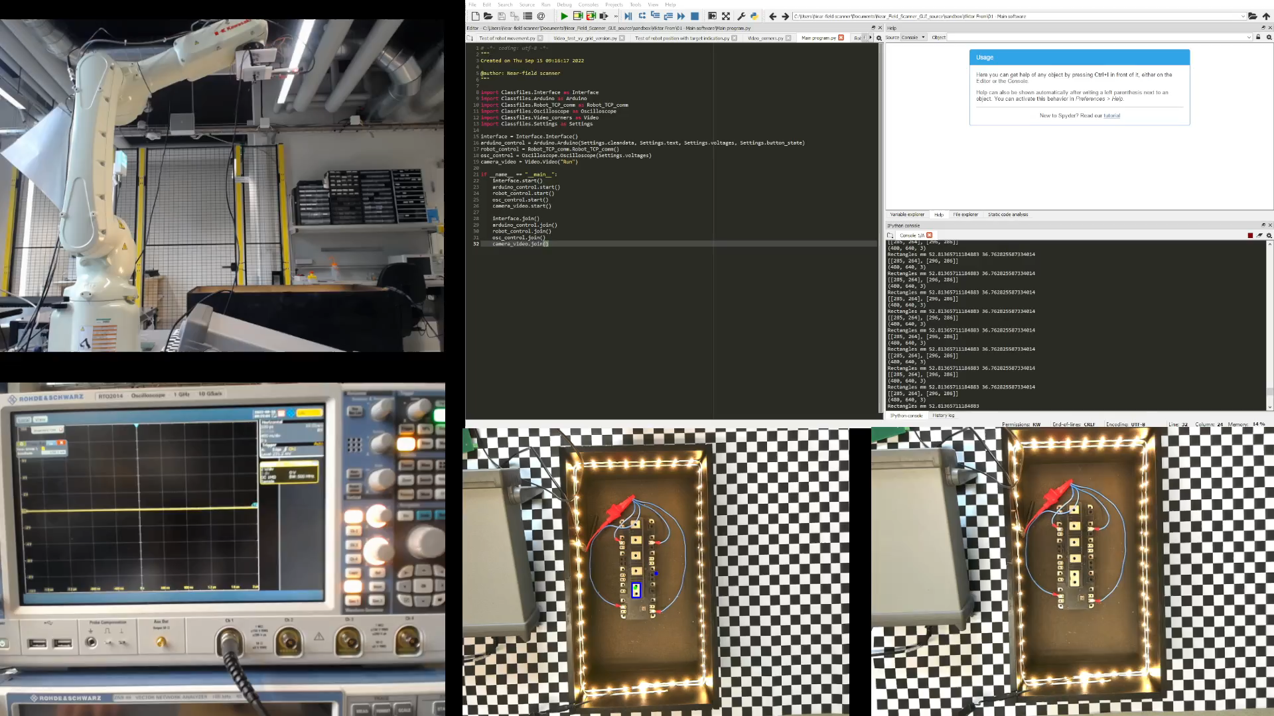
Acceptance test
Notes:
This is the acceptance test for the setup.
In order for the setup to pass the acceptance test, the setup needs to be capable of:
Correctly identifying at least one test point.
Moving the probe to the test point.
Taking one measurement from the test point.
As you can see, the setup is capable of all of this.

Slide 26
Conclusion.
Design allows for one measurement to be taken on a charged unit.
Mechanical design consists of three parts:
Robot tool strut.
Ground plate.
Sensor mount.
Software design consists of:
Floodfill.
Notes:
In conclusion, the setup can do what it is supposed to do.
It can:
Detect the component.
Find a test point on the component.
Move the robot to the test point.
Take a measurement of the discharge coming from the component.

